Slide 1
Linked Storage Representation
There are many applications where sequential allocation method is unacceptable because of following characteristics
Unpredictable storage requirement
Extensive manipulation of stored data
One method of obtaining the address of node is to store address in computer’s main memory, we refer this addressing mode as pointer of link addressing.
A simple way to represent a linear list is to expand each node to contain a link or pointer to the next node. This representation is called one-way chain or Singly Linked Linear List.

Slide 2
Linked Storage Representation
NULL Value
Last Node
A
1000
B
2050
C
3335
D
5000
1000
2050
3335
A linked List
The linked allocation method of storage can result in both efficient use of computer storage and computer time.
A linked list is a non-sequential collection of data items.
Each node is divided into two parts, the first part represents the information of the element and the second part contains the address of the next node.
The last node of the list does not have successor node, so null value is stored as the address.
It is possible for a list to have no nodes at all, such a list is called empty list.

Slide 3
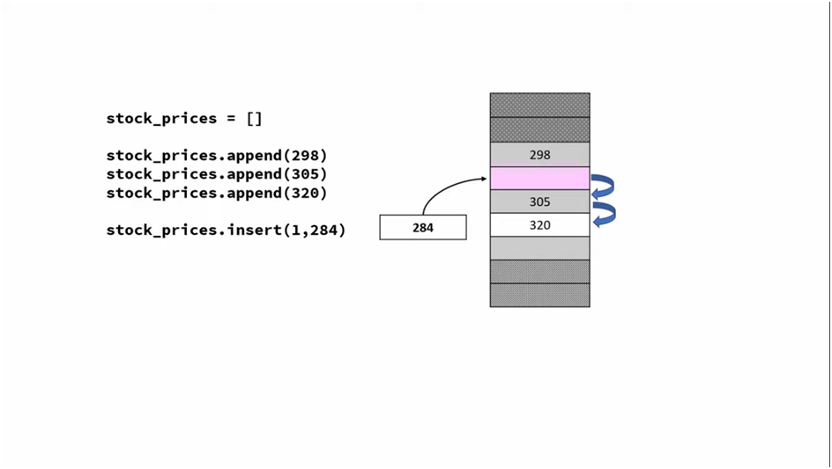
this is static array, where swapping of data required so if we have millions of records to swap then complexity increseas.

Slide 4
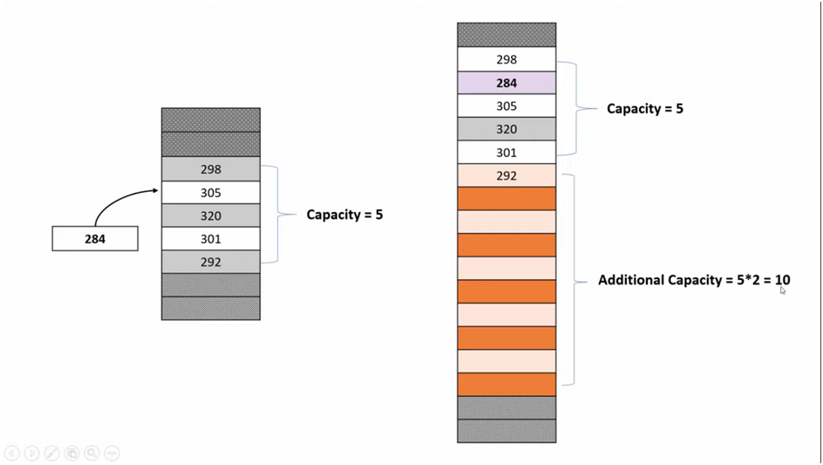
this is dynamic array. Overhead of swapping + allocating new memory +poping all element from old memory area to new memory area .
So it is not sufficient.

Slide 5
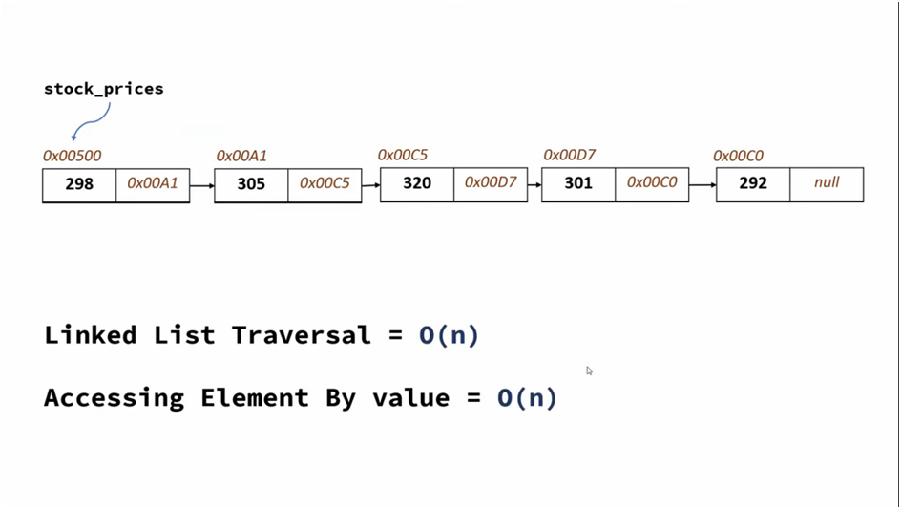
Array stores data in continuous memory location but linkedlist stores data in random memory location which is linked but not in sequence.
Each element has reference to address to next element.

Slide 6
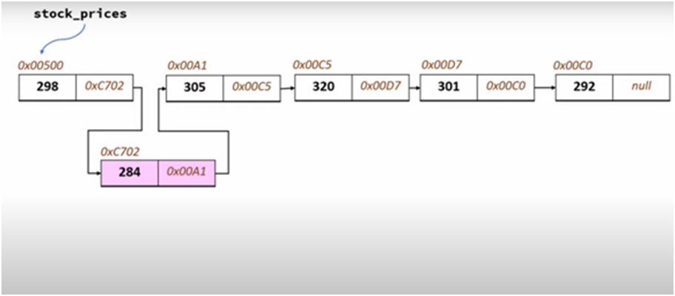
now in this case you just need to add link and not to do copy of all elements downwards which we were doing in array. Just we need to add link & change address. So, insertion is very easy

Slide 7
Insertion Operation
We have an n elements in list and it is required to insert a new element between the first and second element, what to do with sequential allocation & linked allocation?
Insertion operation is more efficient in Linked allocation.
A
1000
B
2050
C
3335
D
5000
1000
2050
3335
A
2100
B
2050
C
3335
D
5000
1000
2050
3335
X
1000
2100

Slide 8
Deletion Operation
Deletion operation is more efficient in Linked Allocation
A
1000
B
2050
C
3335
D
5000
1000
2050
3335
A
2050
B
2050
C
3335
D
5000
1000
2050
3335

Slide 9
Search Operation
If particular node in the list is required, it is necessary to follow links from the first node onwards until the desired node is found, in this situation it is more time consuming to go through linked list than a sequential list.
Search operation is more time consuming in Linked Allocation.
Join Operation
Join operation is more efficient in Linked Allocation.
A
1000
B
2050
C
3335
D
5050
5000
1000
2050
3335
12
580
52
5096
15
5145
100
5050
580
5096
5145

Slide 10
Split Operation
Split operation is more efficient in Linked Allocation
Linked list require more memory compared to array because along with value it stores pointer to next node.
Linked lists are among the simplest and most common data structures
A
1000
B
2050
C
3335
D
5000
1000
2050
3335
A
1000
B
2050
C
3335
D
5000
1000
2050
3335

Slide 11
Operations & Type of Linked List
Operations on Linked List
Types of Linked List
Insert
Insert at first position
Insert at last position
Delete
Delete at first position
Delete at last position
Traverse list (Print list)
Singly Linked List
Circular Linked List
Doubly Linked List

Slide 12
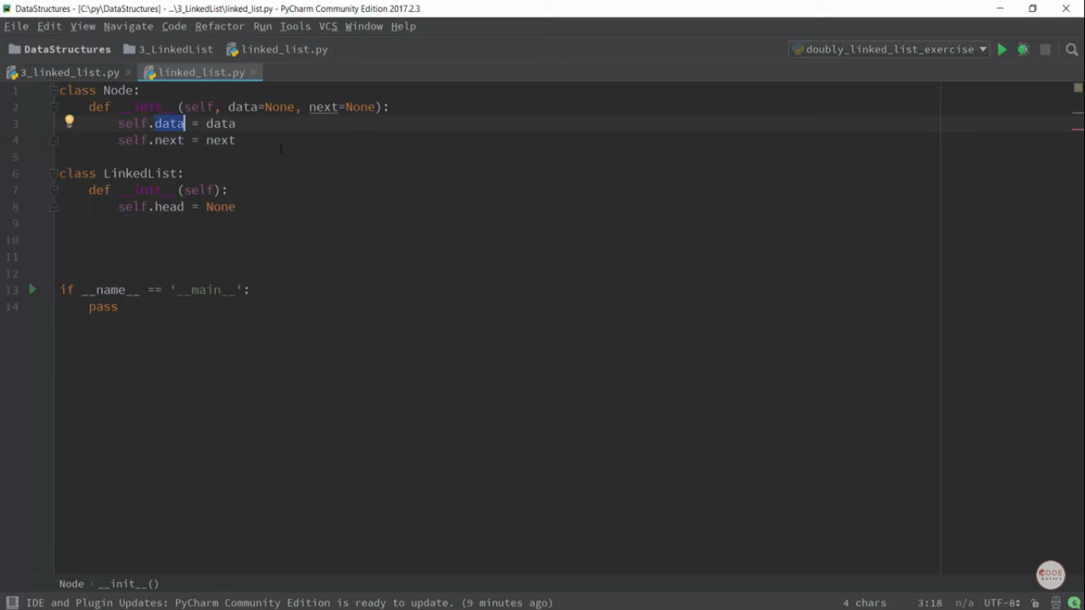
First class is node which has 2 members(1 data- contain integer,pointer or complex things 2 next- address of next pointer) ,second class linkedlist class which has head variable which points to head of linkedlist.

Slide 13
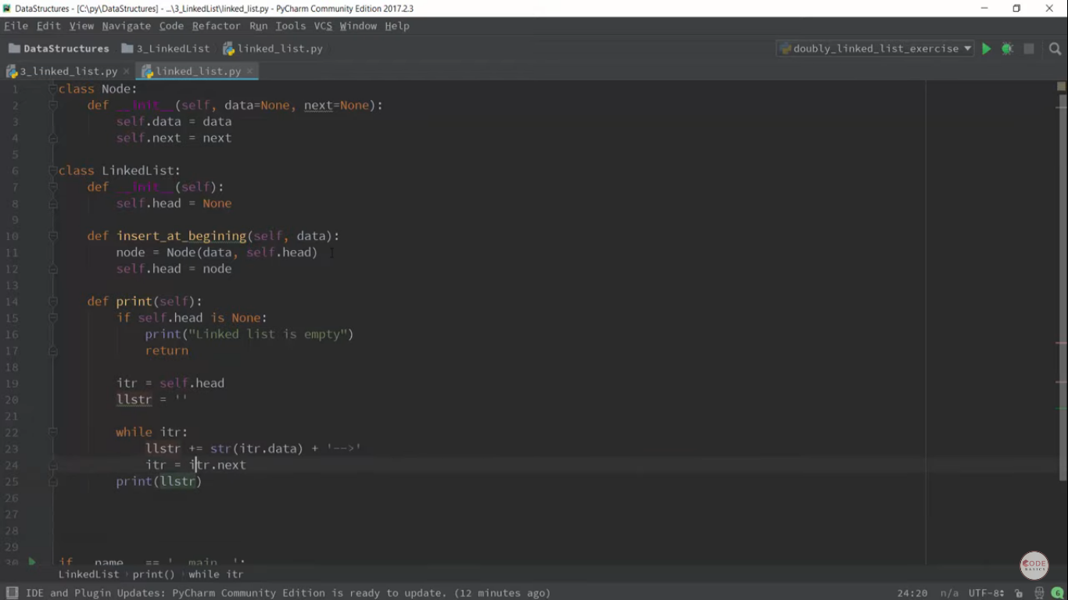
Insert_at_begi→ create node with data when next element come(As it is first element-head is going to point it.)
In print function( check head-if blank then linked list is empty,if not blank–use itr variable to print element,itr is pointer to head,itrstrn is used to print whole linkedlist(collection of node))

Slide 14
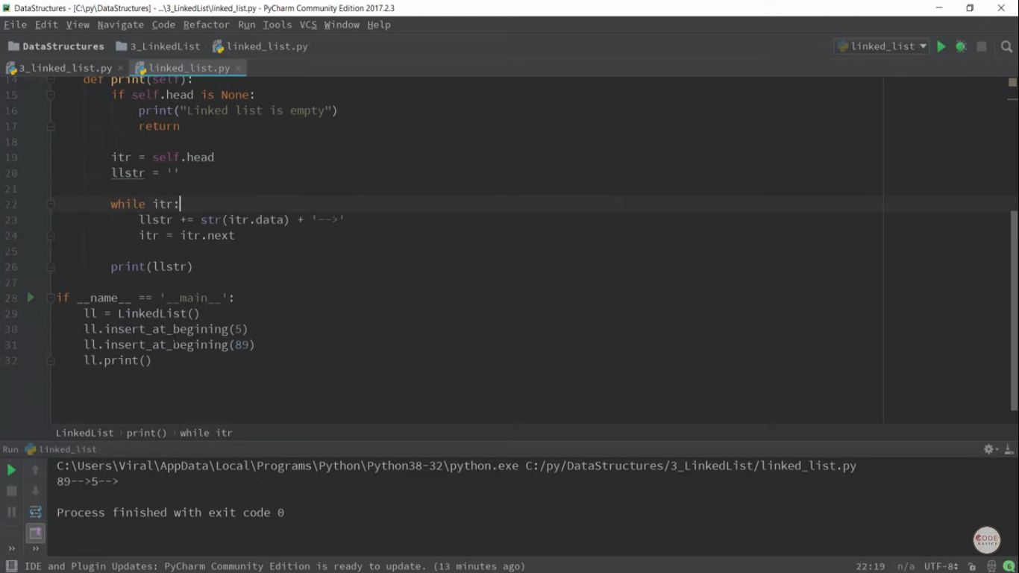
This is the output which mentions the operation of insert at beginning.

Slide 15
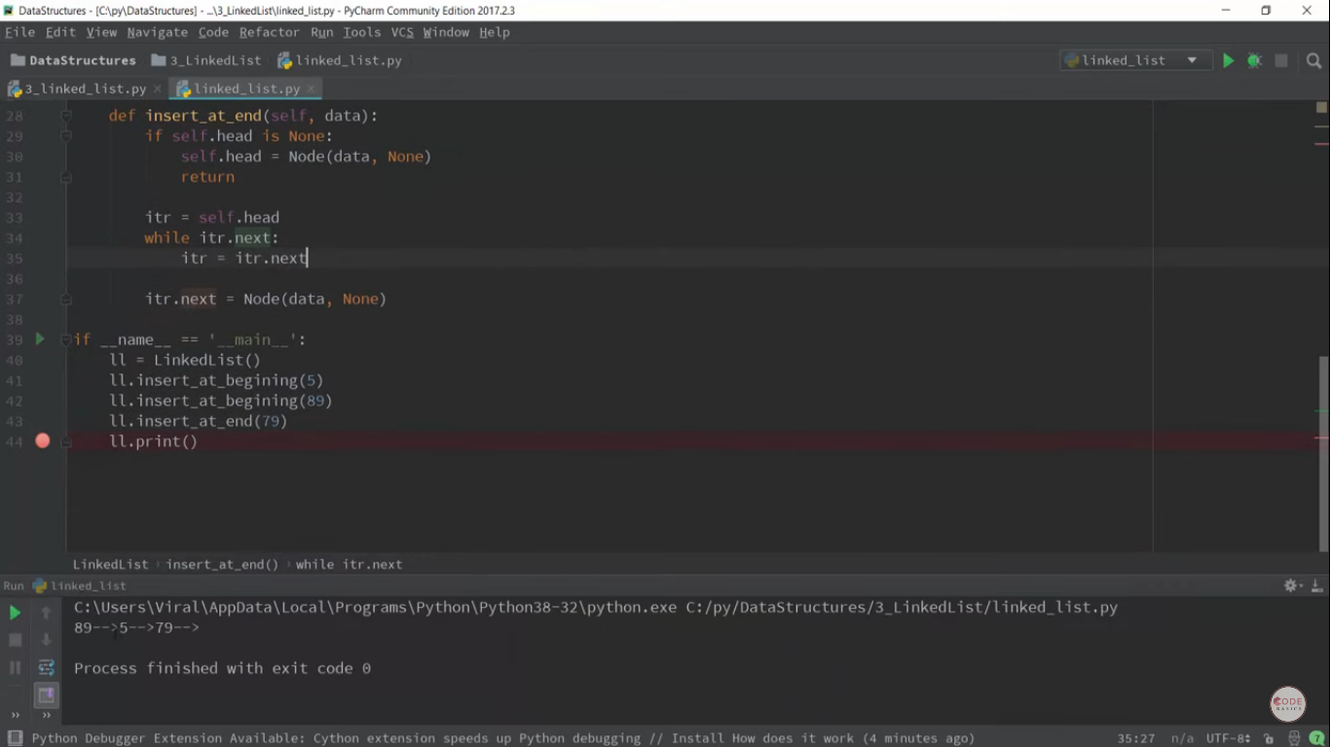
Insert at end -this function checks first if linkedlist is empty then it will insert @ end,if it already has element we are going to have iterator variable which iterate and reach to end of linkedlist then insert value at end,as it is the last element in argument we are giving null value.

Slide 16
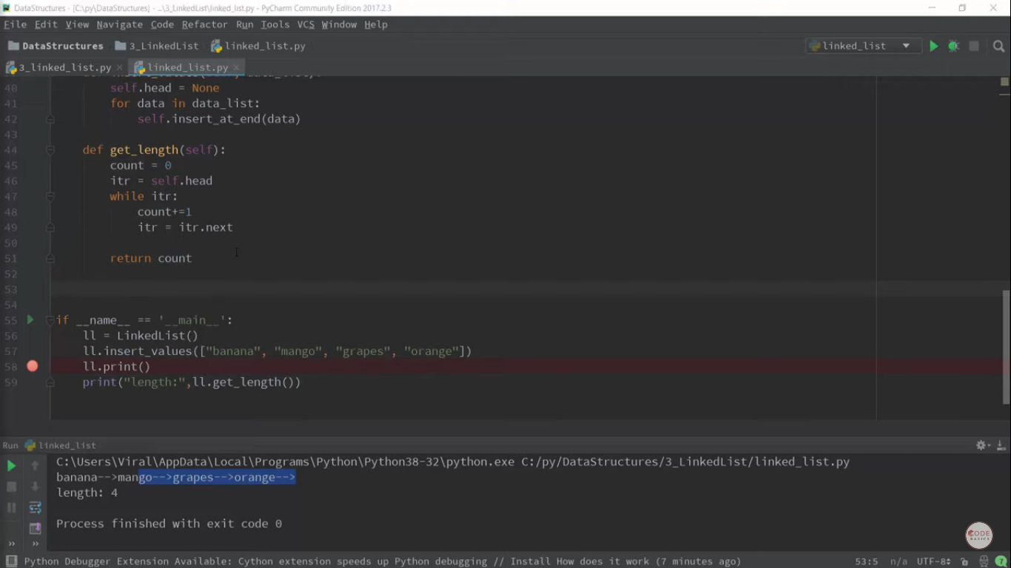
Perform certain different operation like finding length of linkedlist

Slide 17
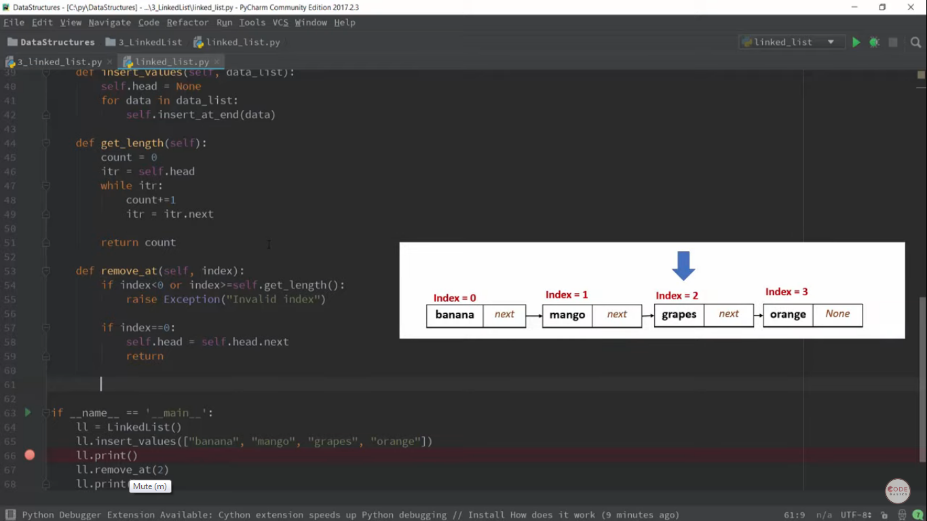
Removing at particular index,if index invalid-throw exception,if index 0,remove element & point to next element,after handling 2 special cases,

Slide 18
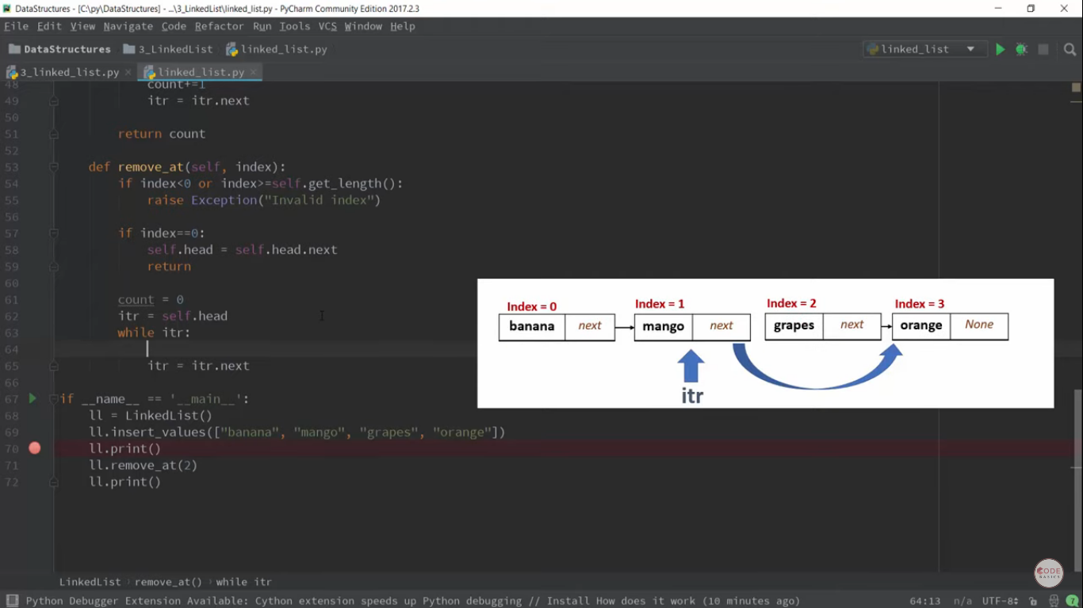
now in linkedlist if you want to reach at particular index then you have to create counter variable and you have to iterate through list.

Slide 19

By reaching at specified index you need to make itr to point to next element’s next element so the element to be deleted wil be automatically removed

Slide 20
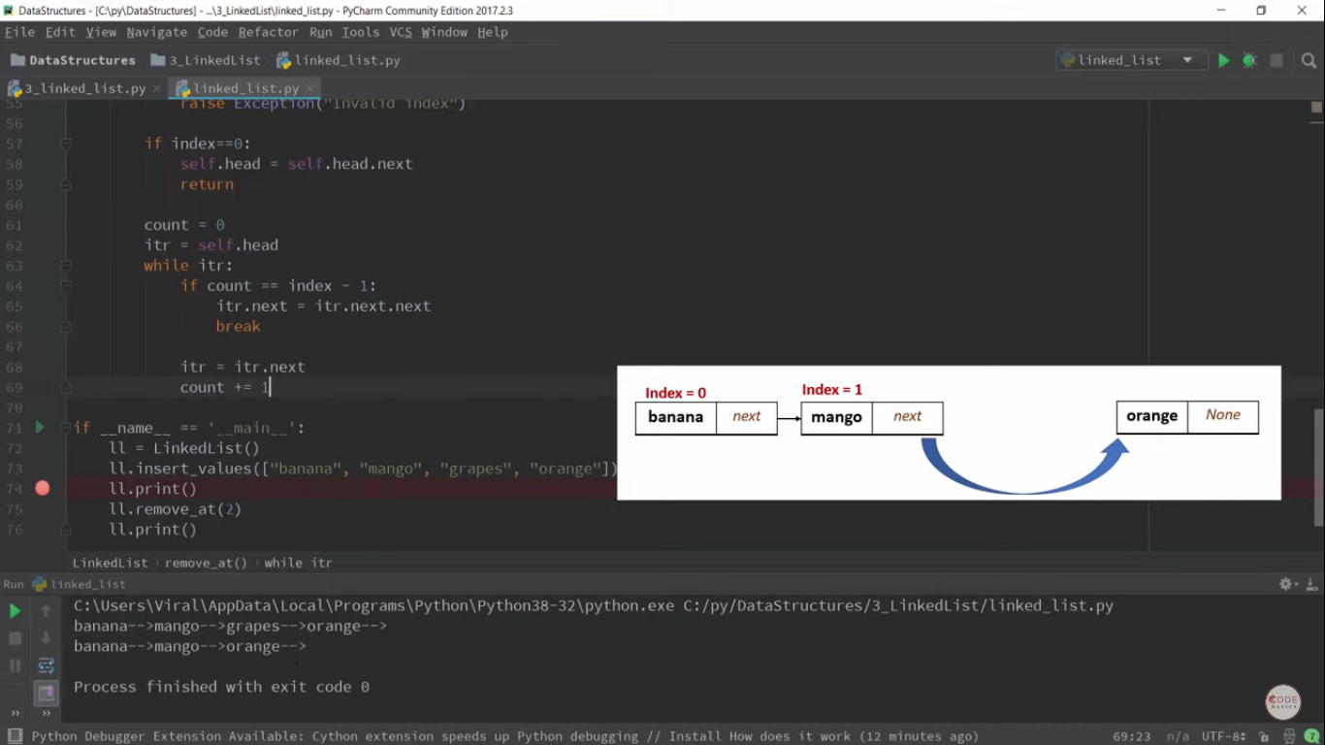

Slide 21
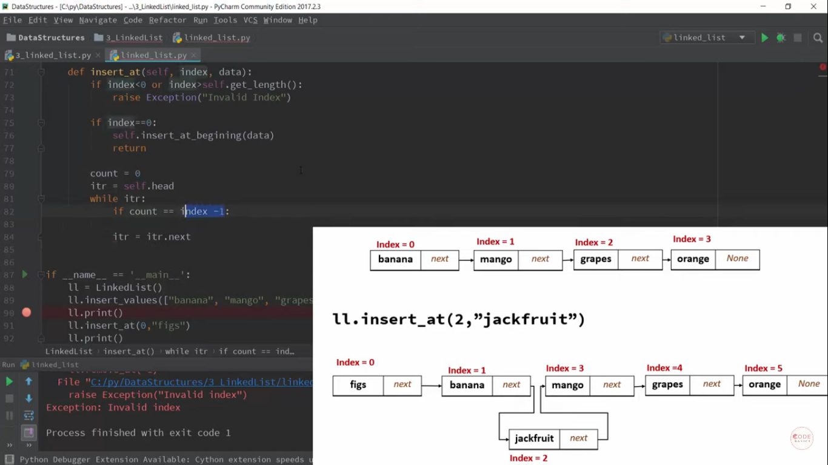
Now use itr and count,iterate loop,we need to stop our count at index-1,as whenever we are inserting element,we modify next pointer of previous element,increment count.

Slide 22
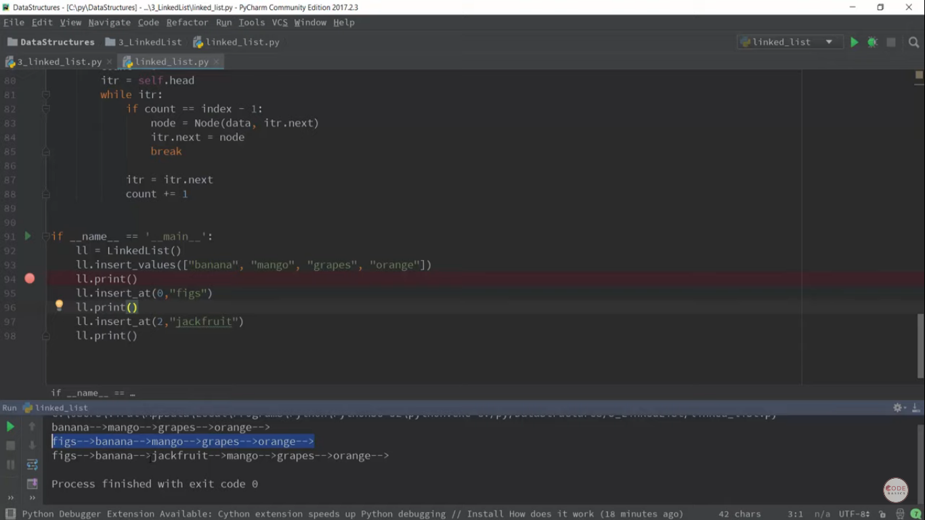

Slide 23
